Slide 1

Oracle 11g: SQL
Chapter 10
Selected Single-Row Functions

Slide 2
Objectives
Use the UPPER, LOWER, and INITCAP functions to change the case of field values and strings
Manipulate character substrings with the SUBSTR and INSTR functions
Nest functions inside other functions
Determine the length of a character string using the LENGTH function
Use the LPAD and RPAD functions to pad a string to a certain width
Use the LTRIM and RTRIM functions to remove specific characters strings
Oracle 11g: SQL

Slide 3
Objectives (continued)
Substitute character string values with the REPLACE and TRANSLATE functions
Round and truncate numeric data using the ROUND and TRUNC functions
Return the remainder only of a division operation using the MOD function
Use the ABS function to set numeric values positive
Use the POWER function to raise a number to a specified power
Calculate the number of months between two dates using the MONTHS_BETWEEN function
Oracle 11g: SQL

Slide 4
Objectives (continued)
Manipulate date data using the ADD_MONTHS, NEXT_DAY, LAST_DAY, and TO_DATE functions
Differentiate between CURRENT_DATE and SYSDATE values
Extend pattern matching capabilities with regular expressions
Identify and correct problems associated with calculations involving NULL values using the NVL function
Display dates and numbers in a specific format with the TO_CHAR function
Oracle 11g: SQL

Slide 5
Objectives (continued)
Perform condition processing similar to an IF statement with the DECODE function
Use the SOUNDEX function to identify character phonetics
Convert string values to numeric with the TO_NUMBER function
Use the DUAL table to test functions
Oracle 11g: SQL

Slide 6
Terminology
Function – predefined block of code that accepts arguments and returns a value
Single-row function – returns one row of results for each record processed
Multiple-row function – returns one result per group of data processed (covered in the next chapter)
Oracle 11g: SQL

Slide 7
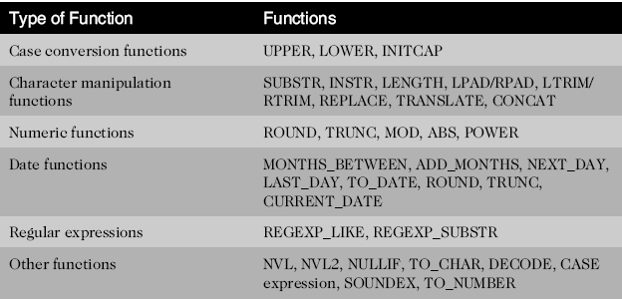
Types of Functions
Oracle 11g: SQL

Slide 8
Case Conversion Functions
Case conversion functions alter the case of data stored in a column or character string
  Used in a SELECT clause, they alter the appearance of the data in the results
  Used in a WHERE clause, they alter the value for comparison
Oracle 11g: SQL

Slide 9
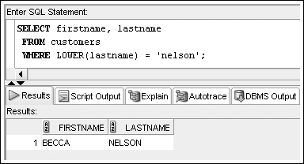
LOWER Function
Used to convert characters to lowercase letters
Oracle 11g: SQL

Slide 10
UPPER Function
Used to convert characters to uppercase letters
Oracle 11g: SQL

Slide 11
INITCAP Function
Used to convert characters to mixed case
Oracle 11g: SQL

Slide 12
Character Manipulation Functions
Character manipulation functions manipulate data by extracting substrings, counting the number of characters, replacing strings, etc.
Oracle 11g: SQL

Slide 13
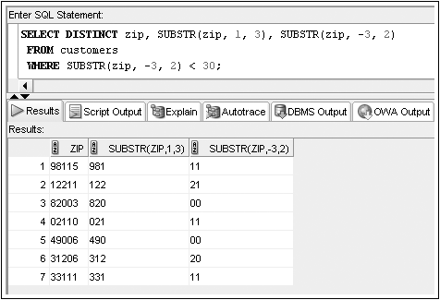
SUBSTR Function
Used to return a substring, or portion of a string
Oracle 11g: SQL

Slide 14
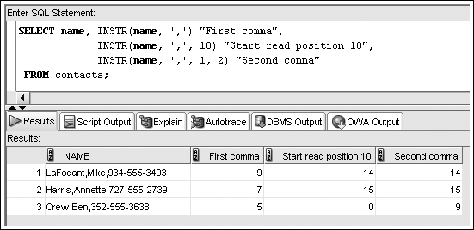
INSTR Function
Position in a string where a substring occurs
Oracle 11g: SQL

Slide 15
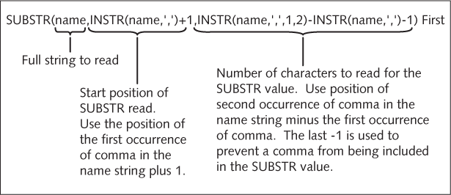
Nesting Functions
Oracle 11g: SQL

Slide 16
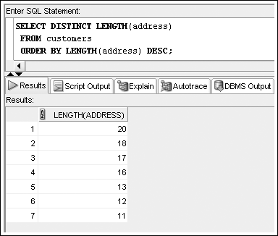
LENGTH Function
Determines the number of characters in a string
Oracle 11g: SQL

Slide 17
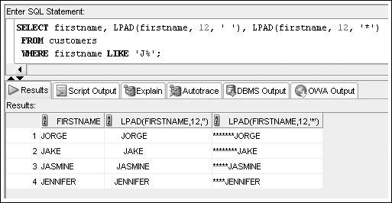
LPAD and RPAD Functions
Used to pad, or fill in, a character string to a fixed width using some character
Oracle 11g: SQL

Slide 18
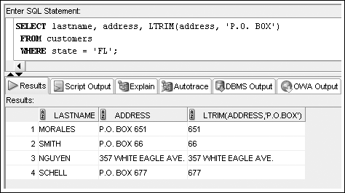
LTRIM and RTRIM Functions
Used to remove a specific string of characters
Oracle 11g: SQL

Slide 19
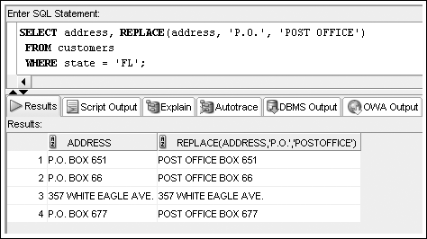
REPLACE Function
Substitutes a substring with another specified string
Oracle 11g: SQL

Slide 20
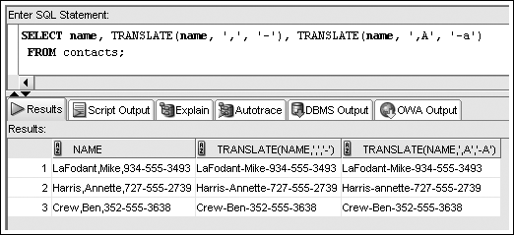
TRANSLATE Function
Oracle 11g: SQL

Slide 21
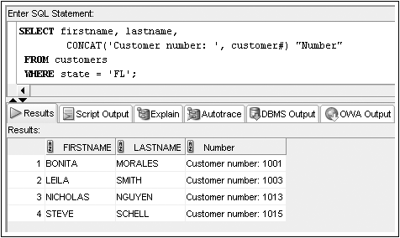
CONCAT Function
Used to concatenate two character strings
Oracle 11g: SQL
Notes:
What if wanted “First Last” format name?
CONCAT(firstname, CONCAT(‘ ’, lastname))
Easier to use || operator

Slide 22
Number Functions
Allow for manipulation of numeric data
  ROUND
  TRUNC
  MOD
  ABS
Oracle 11g: SQL

Slide 23
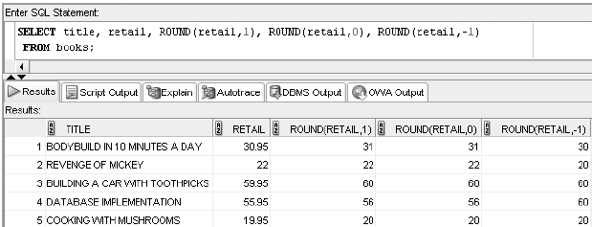
ROUND Function
Used to round numeric columns to a stated decimal precision
Oracle 11g: SQL

Slide 24
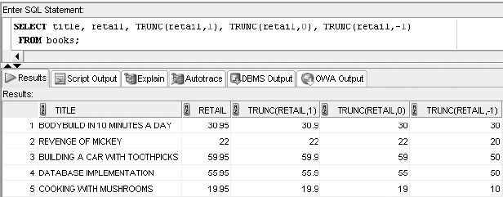
TRUNC Function
Used to truncate a numeric value to a specific decimal precision
Oracle 11g: SQL

Slide 25
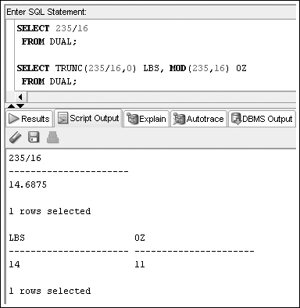
MOD Function
Used to get the remainder from integer division

Slide 26
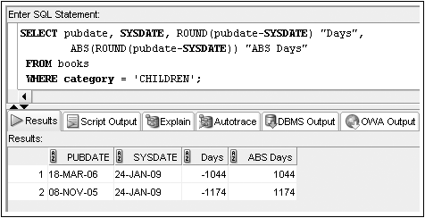
ABS Function
Oracle 11g: SQL

Slide 27
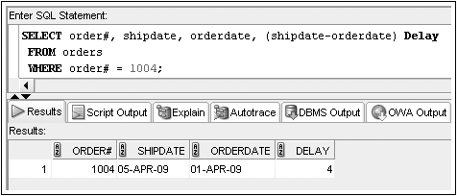
Date Functions
Used to perform date calculations or format date values
Subtract dates for number of days difference
Oracle 11g: SQL

Slide 28
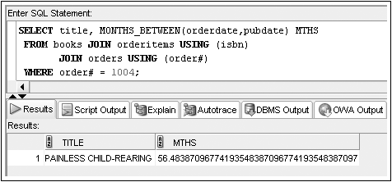
MONTHS_BETWEEN Function
Determines the number of months between two dates
Oracle 11g: SQL

Slide 29
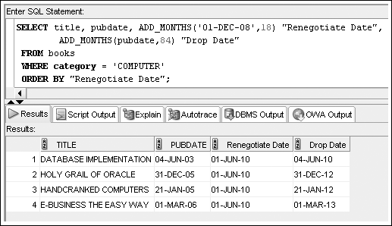
ADD_MONTHS Function
Adds a specified number of months to a date
Oracle 11g: SQL

Slide 30
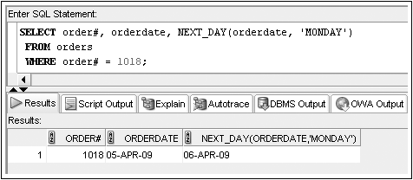
NEXT_DAY Function
Determines the next occurrence of a specified day of the week after a given date
Oracle 11g: SQL

Slide 31
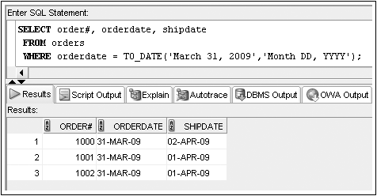
TO_DATE Function
Converts various date formats to the internal format (DD-MON-YY) used by Oracle 11g
Oracle 11g: SQL

Slide 32
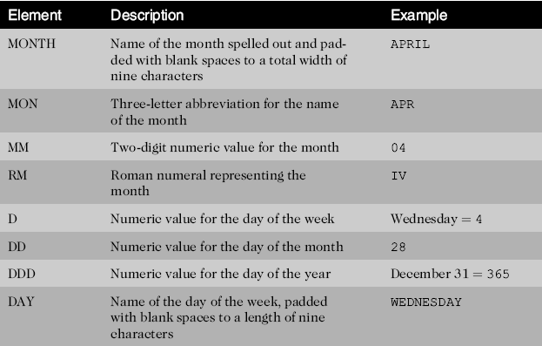
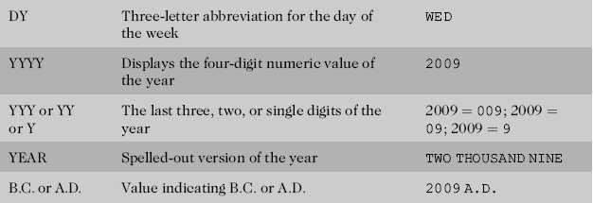
Format Model Elements - Dates

Slide 33
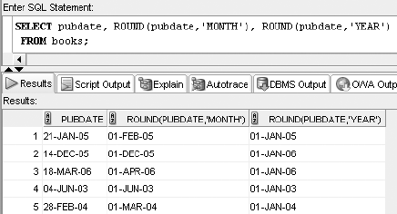
ROUND Function
Oracle 11g: SQL
Notes:
Also a TRUNC function

Slide 34
Regular Expressions
Regular expressions allow the description of complex patterns in textual data
Oracle 11g: SQL

Slide 35
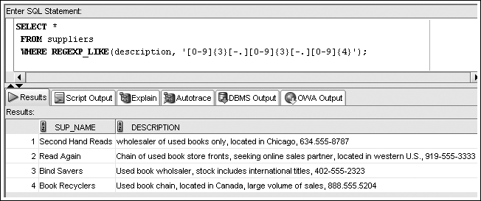
REGEXP_LIKE
Oracle 11g: SQL

Slide 36
Other Functions
NVL
NVL2
TO_CHAR
DECODE
SOUNDEX
Oracle 11g: SQL

Slide 37
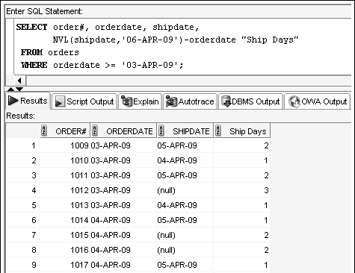
NVL Function
Specifies a value to use in place of NULL
Notes:
Used to avoid NULL → NULL in an operation

Slide 38
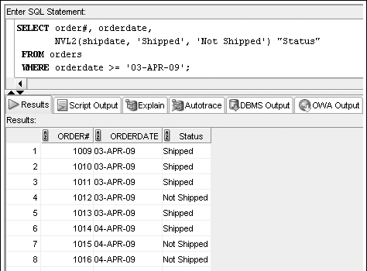
NVL2 Function
Allows different actions based on whether a value is NULL or not

Slide 39
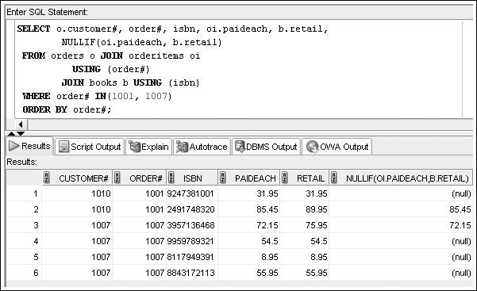
NULLIF Function
Use NULL in place of some value

Slide 40
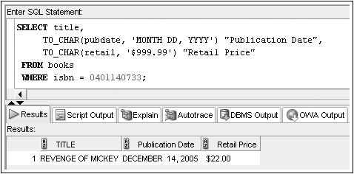
TO_CHAR Function
Converts dates and numbers to a formatted character string
Oracle 11g: SQL

Slide 41
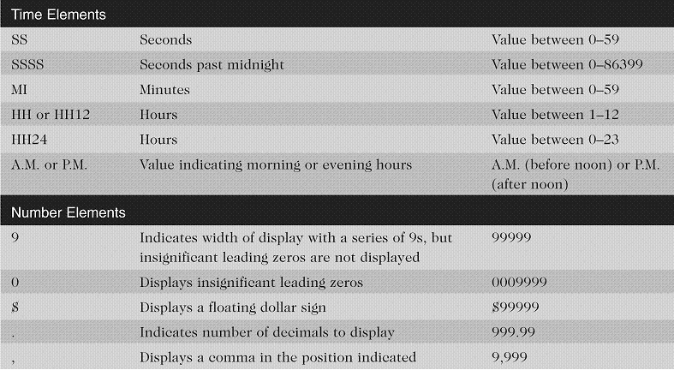
Format Model Elements –
Time and Number

Slide 42
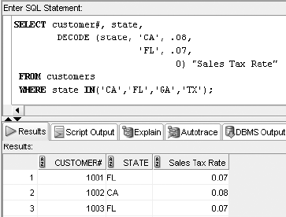
DECODE Function
Determines result based upon values in a list (like a CASE)

Slide 43
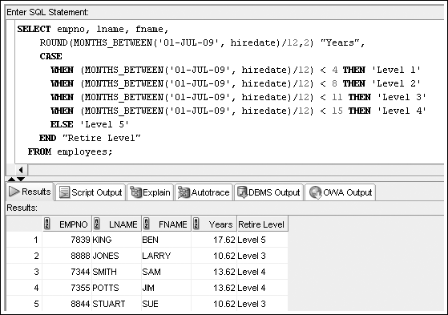
CASE Expression

Slide 44
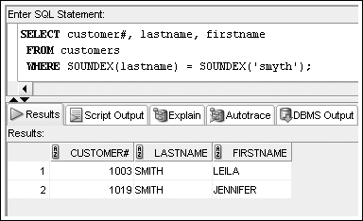
SOUNDEX Function
References phonetic representation of words
Oracle 11g: SQL

Slide 45
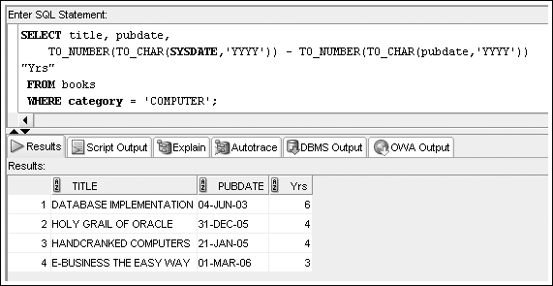
TO_NUMBER Function
Oracle 11g: SQL

Slide 46
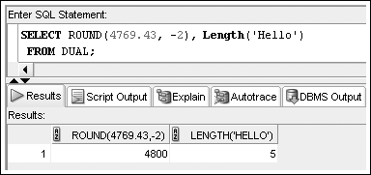
DUAL Table
Dummy table
Consists of one column and one row
Can be used for table reference in the FROM clause
Oracle 11g: SQL

